Slide 1
Opioid Deaths Over Time from 1999 - 2020
Public Health 460
A8- Team 1

Slide 2
Overview
Question:
Is there any discernible change between in the amount of deaths linked to the use of opioid drugs over the course of the opioid crisis (1999-2020)? If so, what years and locations seem to be most affected and why should we be concerned?
Hypothesis:
We are very confident that the deaths will depend on the region and the population of a given region (which is the motivation of including the crude rate; deaths scaled by population). We hypothesize that the regions that have the highest population locations (i.e., cities) will experience the greatest amount of change in deaths; most dynamic; change moves quickly, but also more immediate government response. This would be the Northeast (Boston, New York), and the West (Los Angeles, San Francisco).

Slide 3
Data Processing
Querry:
Census Region
State
Year
1999 - 2020
After 2021, data is considered provisional
Multiple Cause of Death each Year
T40.0 (Opium)
T40.1 (Heroin)
T40.2 (Other Opioids)
T40.3 (Methadone)
T40.4 (Other Synthetic narcotics)
Notes:
From the CDC website, the data we used was the Current Final Multiple Cause of Death Data from 1999 to 2020. We queried the data by the census region, state, year, and multiple cause of death each year.
According to the CDC, when data is grouped by Multiple Cause of Death, the table shows a row for each cause of death mentioned, including the number of deaths and rates. Although each death certificate has only 1 Underlying Cause of death, up to 20 causes can be indicated in the Multiple Cause of Death field. Thus, the total count by "any mention" of cause in the Multiple Cause of Death field may exceed the actual number of dead persons in the selected population.
In our dataset, we defined out multiple causes of deaths by opium, heroin, other opiods, methadone, and other synthetic narcotics. We chose to utilize this time period because it includes 2 decades of information and any time after 2021 was considered to be “Provisional” or there’s a possibility that some of the information already collected could possible change.

Slide 4
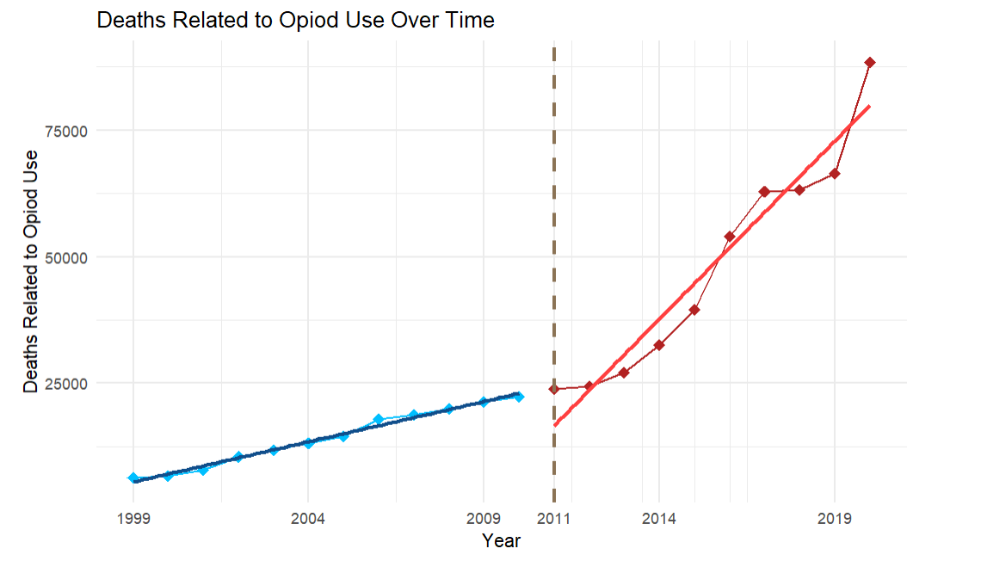
Total Opioid-related Deaths in the U.S
Quantitatively, larger amount of deaths per year after 2011, compared to previous years in the crisis
Moreover, note the difference in increase (slope) between 1999-2010 and 2011-2020.
About 4.5 times as steep; increases 4.5 times as fast
Context:
2011 - Beginning of the “2nd wave” of crisis
Govt. ‘cracks down’ on prescription opioids; increase in use of heroin
2013 - Beginning of “3rd wave” of crisis
Increased availability of fentanyl
***Disclaimer: not including suppressed; suppressed = non-numerical values***
Notes:
-explain historically why there is a spike during this time period (around 2010 and 2011)

Slide 5
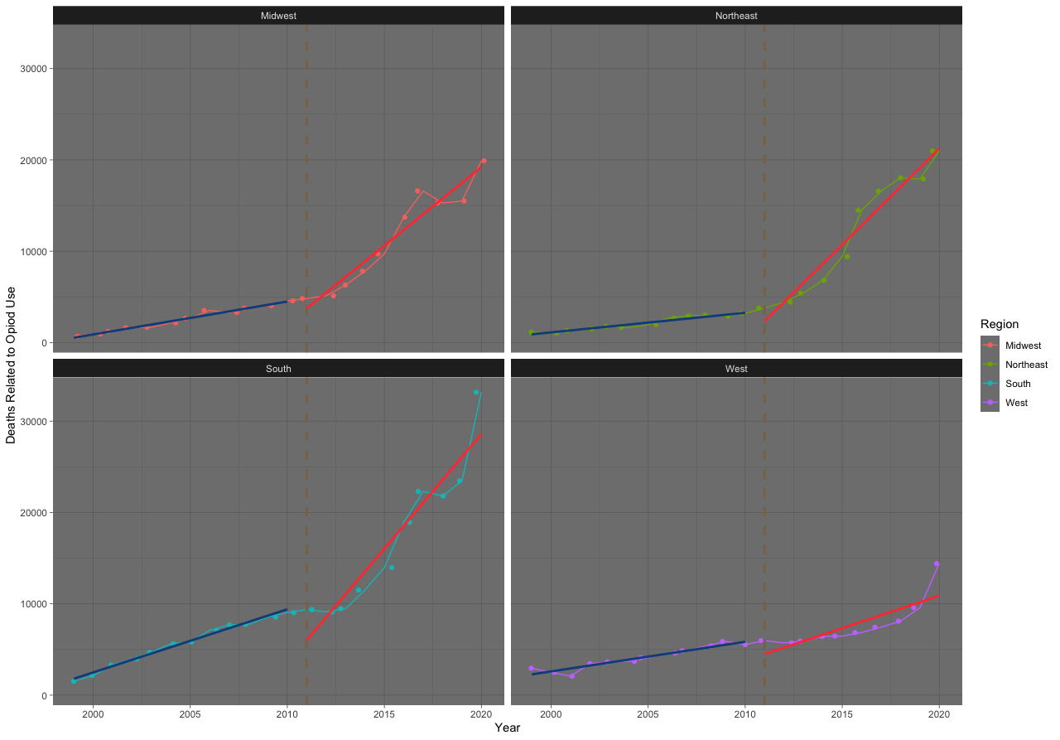
Faceted by Region - Is the Trend Consistent by Region?
Can see a universal increase in death over time even when faceted by region.
Common trend from 1999-2011 of a steady increase in deaths
Further, the same trend from 2011-2020 appears to be consistent (to a lesser degree for the West)
That is: this problem is universally worsening

Slide 6




Aggregate Plots - Analytic Conclusions and Validity of Analysis
As previously mentioned, the rate of change increases noticeably starting in 2011:
x4.5
2011 - 2020
1999 - 2010
Slope
Slope
Note: Multiple R²: The percentage of the total change in the deaths is accounted for in the model; “how accurately does this model reflect the data; closer to 1 is better”.
Midwest
Northeast
South
West
Notes:
Midwest

Slide 7
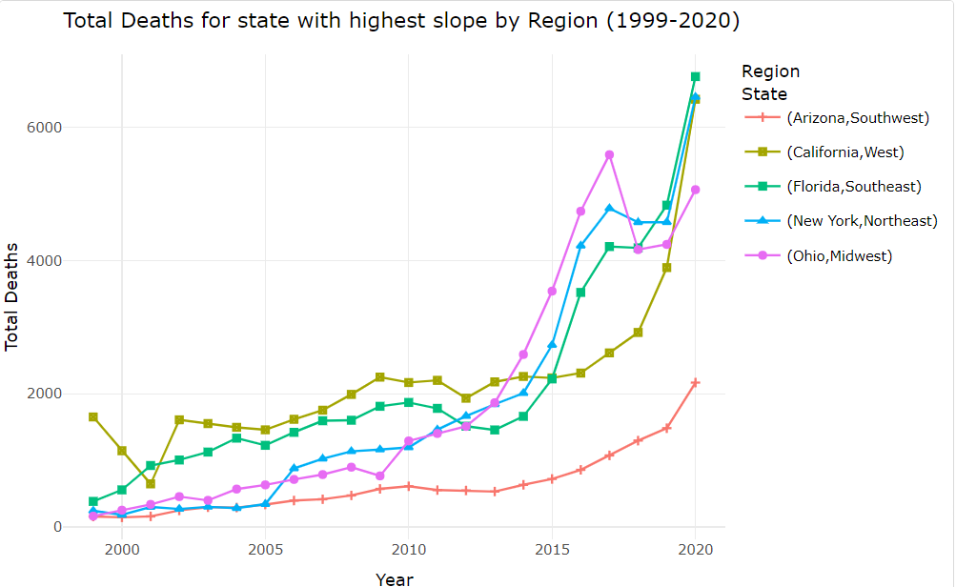
Case Study: Five States from Different Regions

Slide 8
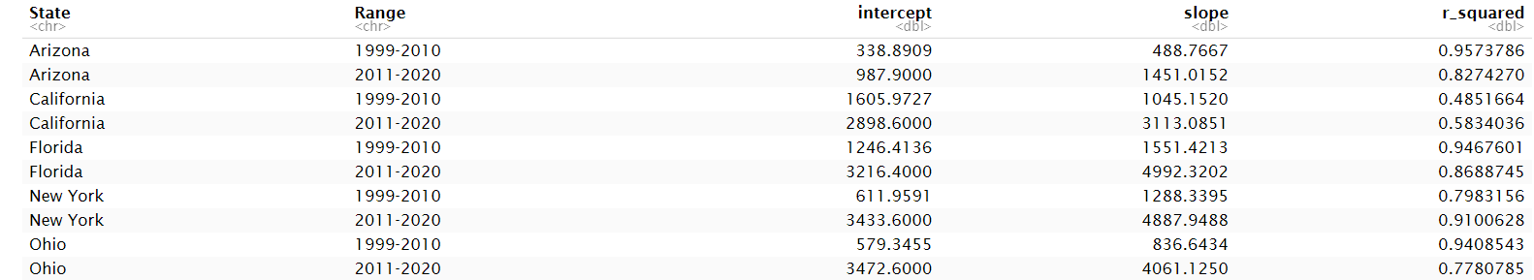
Case Study: Five States from Different Regions

Slide 9
Explanation of Five States Case Study
The previous graph extracts the state with the highest increase of total death over time when compared to states in their respective region.
As observed, from 2000-2010 There is a relatively steady increase in the number of deaths over time for every state depicted.
From 2011-2020, the slope of the Total Deaths vs Year lines for every state experienced a notable upward spike.
The trend remains consistent in specific states within a general region. As well as the hypothesis, as these states would the highest population within each region and a noticeable high change in death rate
Regions in the West (California), Southeast (Florida), and Northeast (New york) are seen to have the highest total deaths

Slide 10
Crude Rate (death by 100,000) of U.S.
** *Multiple R² based on a nonlinear (logarithmic) regression model; fit by Box-Cox Method***
Notes:
Potentially, we could have only mainly focused on the variable total deaths over time, but the number of total deaths does not account for states and areas that have either small or large population sizes. For instance, states with a higher population density will tend to accumulate higher total deaths. Therefore, when looking at the death toll, we must account for crude rate as a variable for comparison. Defined by the CDC, Crude rates are expressed as the number of deaths reported each year per 100,000 population; or crude rate is equal to the number of deaths divided by the population multiplied by 100,000.
The animated map displays the crude rate of opioid-related deaths from 1999 to 2020. The cream light shapes represent low crude rates of 0.0 to 3.2 while the highest is a dark red shade representing crude rates of 11.675 and over.
1999 - 2010: you can see the initial light cream color fade into an orange
Once 2011 hits, you can see the dramatic transition to darker colors across the states
For crude rate, the scatter plot did not show a linear regression; it showed a logarithmic model. Because there is a logarithmic function, fitting a linear regression model would create a low correlation and R-squared value. So instead, we utilized the Box Cox Transformation to help compute out R-Squared.
The Box Cox Transition is a statistical method to transform non-normal dependent variables into a normal distribution which improves the accuracy of predictions of a linear regression.
R^2 = .97 (for aggregate crude sum) which means about 97% the expected increase in crude rate deaths per 100,000 is reflected by the model, respectively
In the next slide, we specifically wanted to highlight the trend of just Massachusetts

Slide 11
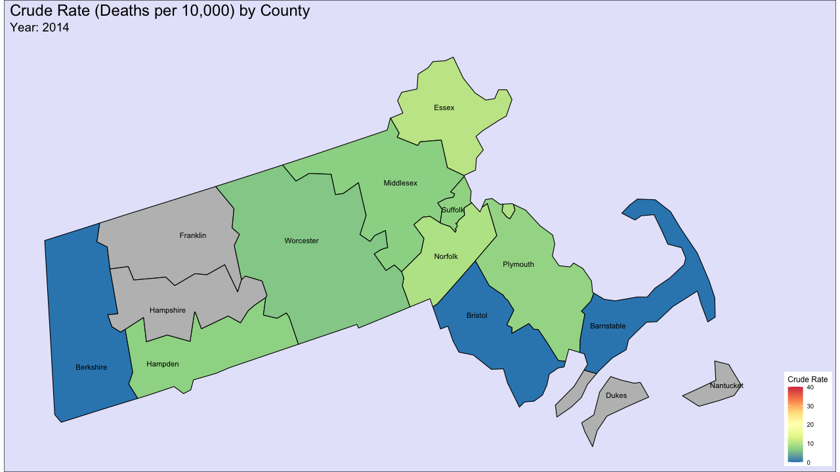
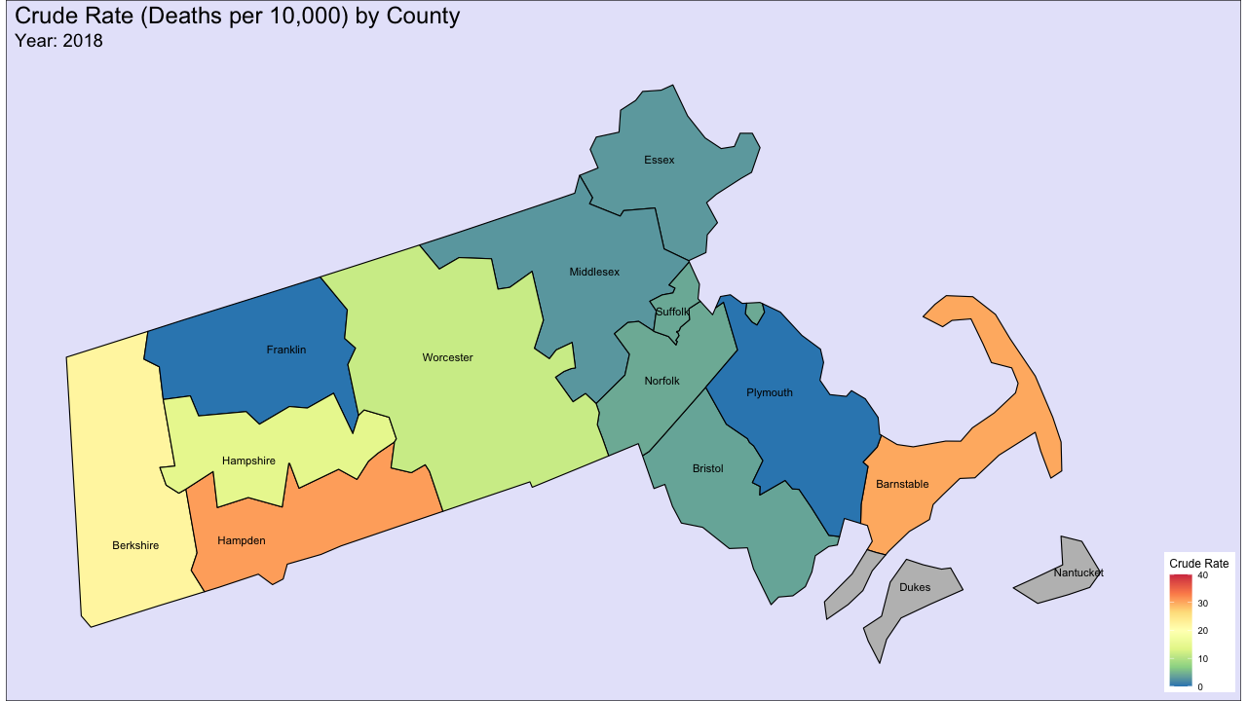
Case Study: Massachusetts Faceted by County (Crude Rate)
How has this affected us, over our adolescence?
How will it affect us?
Prediction:
Suffolk County high? (Boston)
2014-2018 had most consistent set of data (least missing)
Notice: Hampden and Barnstable Counties
** Dukes County/Nantucket had negligible crude rate**

Slide 12
Policy Implementation
This study is not causatory, i.e., it does not explain why we see this trend; simply brings attention to this trend and offer possible explanations.
Increase in total deaths over the past 20 years
Increase in deaths per year, beginning in 2011
Regardless of geography
Specifically, the Northeast
We saw Massachusetts as an example
Next steps:
Perform further studies on more specific trends; e.g., relation to number of prescriptions, is there an increase in drug use, or is it simply an increase in fatality.
Address medical and health professionals on reasons why there is an increase.
What are some possible effective policy changes that can control this trend?
Availability of addiction aid facilities
Allocation of funds to lower income areas
Better education
More careful prescription practices

Slide 13
References
Centers for Disease Control and Prevention. (n.d.). Multiple Cause of death 1999-2020. Centers for Disease Control and Prevention. https://wonder.cdc.gov/wonder/help/mcd.html

